Slide 1



Non-Verbal Reasoning Tests
© Laura Hooke, Loughborough University of London. Reviewer: Dr Kinga Zaczek, Royal Holloway, University of London
All mccp resources are released under a creative commons licence, www.mathcentre.ac.uk
www.sigma-network.ac.uk Non-Verbal Reasoning
Notes:
This presentation is an introduction to the different methods that some employers in the UK use to assess applicants for jobs.

Slide 2
Recruitment process
When applying for jobs you may come across some, if not all, of the following stages in the recruitment process:
Completion of an online application form
Submission of a CV and cover letter
Tests (assessing skills appropriate for the job)*
Interview (face to face, video or telephone)
Assessment Centre (online/virtual or actual)
* Tests can occur at any stage of the recruitment process
Notes:
The process of applying for a job varies between employers. For some, submission of a CV and cover letter may be followed by an interview and hopefully, the offer of a job. For other, often larger organisations, there may be several stages to the process. At each stage, applicants may be rejected.
The stage at which the majority of applicants fail is often at the beginning with the submission of a CV or online application form. Common reasons for not passing the initial application stage include:
Not meeting the eligibility criteria e.g. Minimum qualifications requirement
Making errors e.g. Spelling and grammar mistakes
Tests are not used by all employers but are quite commonly used by larger organisations. They can be used at any stage of the recruitment process but are often the next stage after initial application. Tests are taken online so, to avoid fraud many employers will re-test at a later stage e.g. At assessment centre.

Slide 3
Common assessment tools
Ability or Aptitude Test
Including numerical reasoning, verbal reasoning, non-verbal reasoning
Personality Questionnaire
Less commonly used in recruitment
Situational Judgement Test (SJT)
Usually designed specifically for the needs of the job
Notes:
There are many different types of ability tests designed to assess different skills. Some are skills required in many jobs e.g. numerical and verbal reasoning. Others are specific to particular types of jobs e.g. in technology.

Slide 4
Current innovations in recruitment
Some of the large organisations in the UK that recruit students and graduates to internships, placements or graduate schemes are using new methods of assessment during selection e.g.
Online games & videos mirroring typical work scenarios & requiring decisions
Video interviews recorded online by the applicants & reviewed by the recruiter
Notes:
Some of the larger organisations in the UK are introducing new ways to assess applicants online including games and videos e.g. Barclays. Some incorporate elements of tests e.g. Situations that require decisions and interpretation of data. Look at the graduate recruitment pages of the Barclays website.

Slide 5
Ability Tests
Measure a specific ability or abilities required for a job
Often bought from specialist companies
Examples:
numerical reasoning
verbal reasoning
non-verbal reasoning (diagrammatical, inductive, logical)
critical thinking
Notes:
Ability tests are sometimes also called ‘aptitude’ tests. They are designed to assess an applicant’s level of ability in a specific skill.

Slide 6
Non-Verbal Reasoning Tests
Are often used to assess ability to problem solve & to think analytically
Do not require prior knowledge
Examples include:
    diagrammatic reasoning
    logical reasoning
    inductive reasoning

Slide 7
Non-Verbal Reasoning Tests: questions
Questions may use a series of different configurations of shapes that form a logical sequence
The task is often to identify a missing shape in the sequence or decide which configuration should come next
The answer is often multiple choice
Similar questions may be used as part of the entrance exams for some schools in the UK
Notes:
Non verbal reasoning tests use visuals in the test questions e.g. shapes. They often require the applicant to recognise a pattern in a series of configurations of shapes. Using logic, the applicant usually has to identify the missing shape or next stage in a sequence of shapes by choosing from a selection of possible answers.

Slide 8
Numerical Reasoning Practice Questions
The examples on the following slides have been taken, with permission, from a practice test on the Assessment Day website www.assessmentday.co.uk

Slide 9
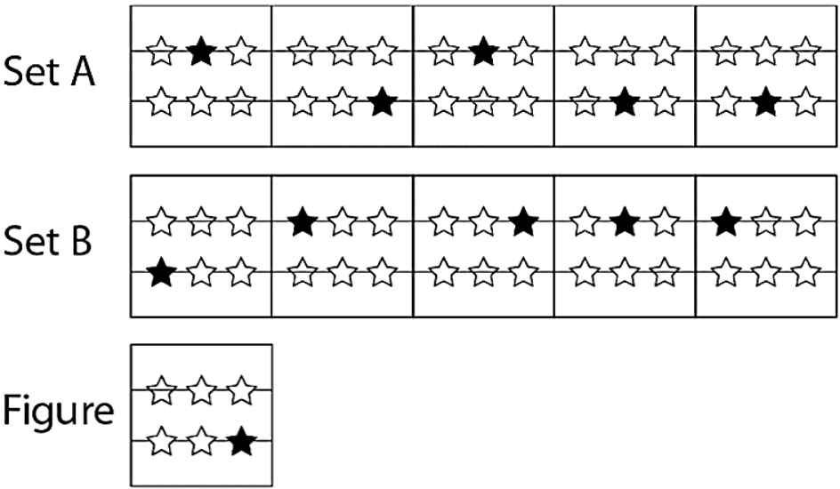
Diagrammatic Reasoning Example Question
Which set does the Figure belong to?
Set A b) Set B c) Neither set A nor set B
Source: www.assessmentday.co.uk

Slide 10
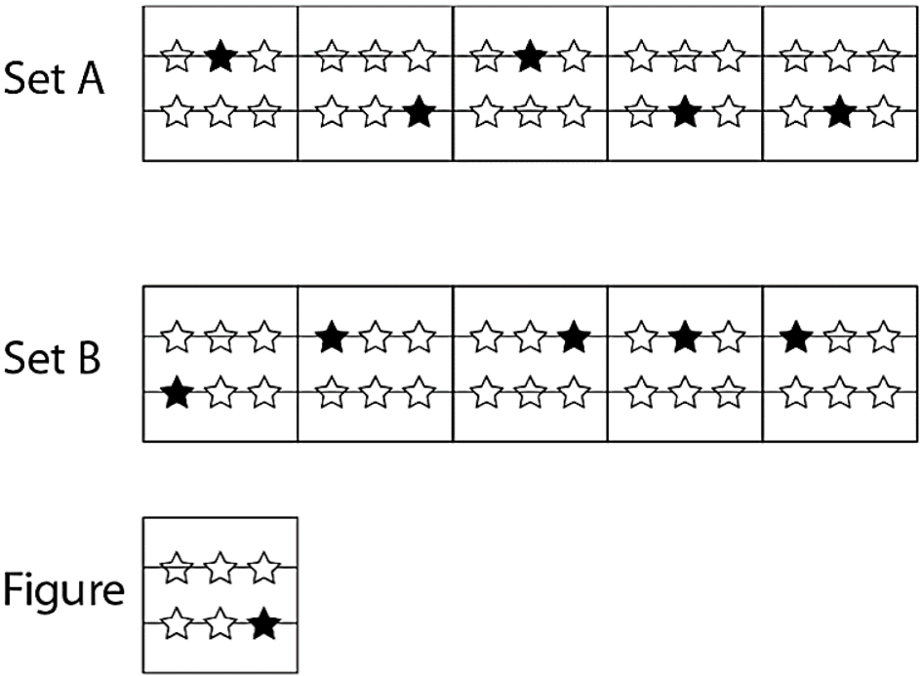
Diagrammatic Reasoning - ANSWER
Set A: Each box contains exactly one shaded star and two stars behind the lines.
Set B: Each box contains exactly one shaded star and one star behind the lines.
Figure: The Figure contains one shaded star and one star behind the lines.
Answer: The Figure belongs to set B.
Source: www.assessmentday.co.uk

Slide 11
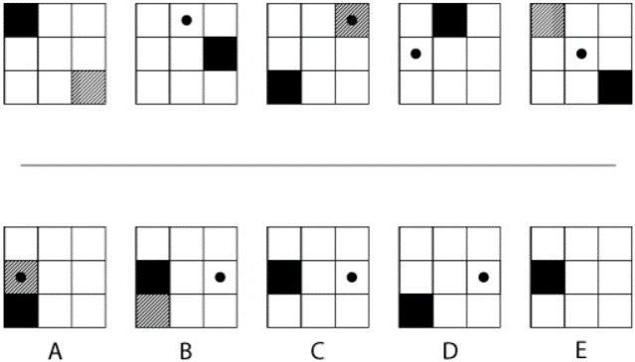
Inductive Reasoning Example Question
Which of the five A-E figures is next in the sequence?
Source: www.assessmentday.co.uk

Slide 12
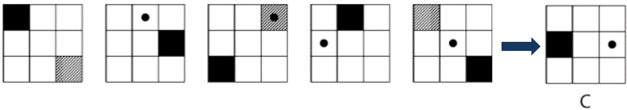
Inductive Reasoning - ANSWER
1st Rule: Each step, the shaded square moves 3 squares clockwise round the edge of the figure.
2nd Rule: Each step, the cross-hatching moves 1 squares anticlockwise round the edge of the figure, disappearing behind the shading when the two coincide.
3rd Rule: The circle (which starts behind the shaded square in figure 1) moves 1 square left to right, starting again at the left of the figure when it drops down a row.
Answer: C
Source: www.assessmentday.co.uk

Slide 13
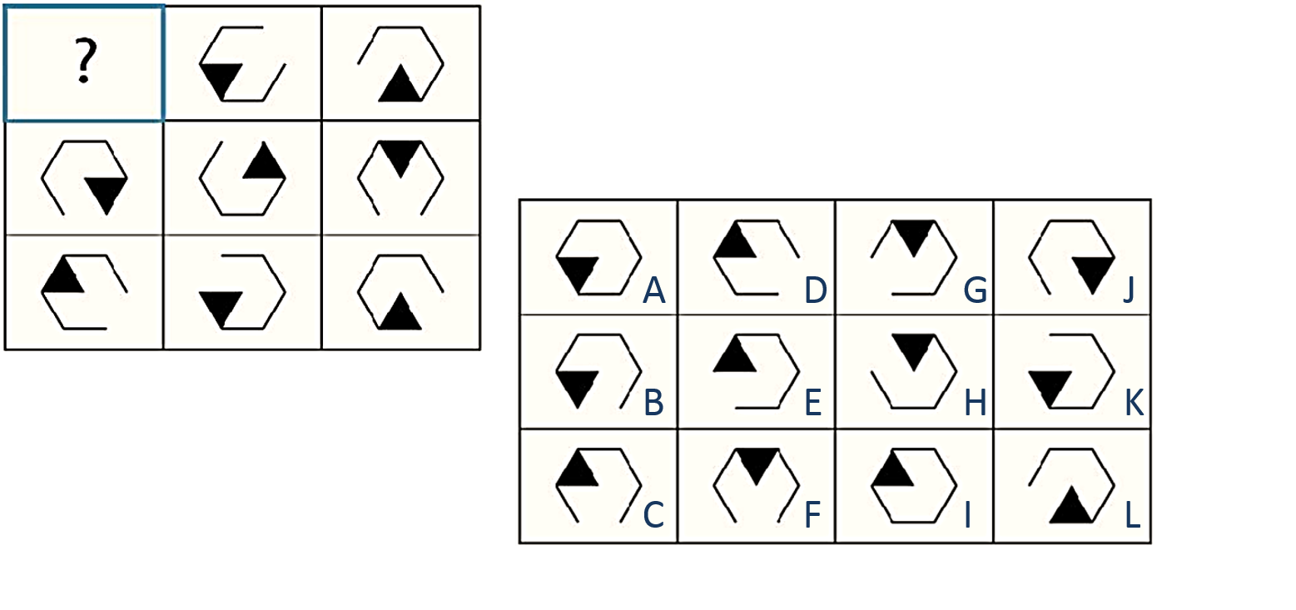
Logical Reasoning Example Question
Which of the figures A – L replaces the question mark?
Source: www.assessmentday.co.uk

Slide 14
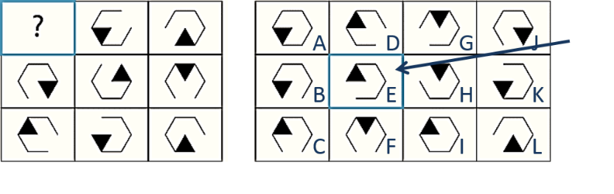
Logical Reasoning - ANSWER
1st Rule: From top to bottom, the missing edge of the hexagon moves one place counter clockwise each time. This pattern continues onto the next column.
2nd Rule: From left to right, the shaded segment of the hexagon moves one place counter clockwise each time. This pattern continues onto the next row.
Answer: E
Source: www.assessmentday.co.uk

Slide 15
Preparing for Non-Verbal Reasoning Tests
Research the type of test you may have to take
  Try an appropriate practice test
    If you find it difficult, look at the answers and tips
      Take a practice test again
        Have you improved?
Notes:
3.
Take another practice test when you have addressed any weaknesses
5. If you have not improved, seek advice e.g. From your university careers service.

Slide 16
Preparing for tests – Research
Look at employers’ websites to see the type of tests they use, e.g. logical reasoning, diagrammatic reasoning etc.
The website may also have example questions and tell you whose tests they use.
Look at websites like Glassdoor or Wikijobs for feedback from others who have already applied to the same employer.
Notes:
Look on the websites of companies you are likely to apply to:
Do they use a non verbal reasoning test
If so, what kind of non verbal reasoning?
Try out any example questions they might have on their website
Glassdoor and Wikijobs may have information about the company or companies that interest you and may have feedback from previous applicants

Slide 17
Preparing for tests – Practise
When you know the type of test you may face, get some practice first, e.g. try the tests on the Assessment Day or Graduates First websites.
If you know which test producer the employer uses, see if there are example questions on the producer’s website. Many of these are listed later in this presentation.
Notes:
If the company or companies that interest you do use a non verbal reasoning test, try an appropriate practice test ideally one that provides the answers when you have finished to help you identify where you went wrong. For example, the practice tests on the Assessmentday website.

Slide 18
Preparing for tests – Improve
Q: Not answering many questions but getting most or all
answers correct?
A: Take more practice tests and focus on increasing your speed.
Q: Answering most or all of the questions but getting a low
score?
A: Work on your accuracy e.g. check your answers
Q: Lacking knowledge/skills?
A: Look for resources that explain non-verbal reasoning tests and include practice questions (with answers). Some suggestions are on the slide ‘Other Useful Resources’.
Notes:
Many people find non-verbal reasoning tests difficult. Practice may help and the suggestions on the ‘Other Useful Resources’ slide include books that provide plenty of example questions with answers and explanations to help with understanding.

Slide 19
Preparing for tests – Try again
When you have practised your speed, improved accuracy or developed your knowledge of non-verbal reasoning tests, try a test again.
With some tests, it is not always necessary to answer all of the questions to do well. You just need to get enough answers correct.

Slide 20
General Practice Test Sites
www.assessmentday.co.uk
www.graduatesfirst.com
Answers are provided after taking each test, so you can analyse where you are going wrong.
Tips and advice are also provided.
Both sites include practice tests of non-verbal reasoning
Notes:
These sites include free practice tests that provide answers and explanations. This is particularly helpful as you can identify any areas in which you need to improve.

Slide 21
Non-Verbal Reasoning Tests: practice tests
https://www.assessmentday.co.uk/inductive_reasoning.htm
https://www.assessmentday.co.uk/aptitudetests_logical.htm
https://www.assessmentday.co.uk/aptitudetests_diagrammatic.htm
These links are to free practice tests at www.assessmentday.co.uk
Notes:
To get an insight into different non verbal reasoning tests, try one or two practice tests.
Tutors: this would be a good point for students to try one of these tests under test conditions. Decide if you want them to do a paper test. If so, print off copies of one of the free tests (and copies of the solutions). Alternatively, if you are able to use a computer lab or instruct students to bring their own laptop or tablet/ipad they can take the test online.
You can follow these steps:
Stop the presentation at this point. Before moving on to the test, ask if students need a quick break (once the test has started they should not leave the room, except in emergencies).
When everyone is ready, distribute the printed test or instruct students to log in using one of the links above
Instruct students not to turn over the front page or to start the test yet
Ask them to read the instructions as you read them out loud. Display them on screen if students are completing the test online
Ask if they have any questions before you start
Instruct them to start the test
Set a stop watch when the test starts (also note the time in case the stopwatch fails)
At the end of the paper test, instruct them to stop. The online test stops automatically
Give out the solutions paper and students can mark their own test. Students completing the test online receive their result immediately but can then look at the answers to see where they have gone wrong.
Return to the remaining slides when you and the students are ready.

Slide 22
Practice Tests Offered by Test Producers
CEB Gartner (SHL)
https://www.cebglobal.com/shldirect/en/practice-tests
Cubiks
https://practicetests.cubiks.com/
Talentlens (Pearson)
https://www.talentlens.co.uk/practice-aptitude
Saville Assessment
https://www.savilleassessment.com/PracticeTests
TalentQ
https://www.trytalentq.com/
Capp
http://practice.cappassessments.com/
You may have to register & create a password before taking a practice test
Notes:
These well known companies produce tests to be used in recruitment. They publish example questions and in some cases, practice tests too. Many of these sites will require you to register, with basic personal details, and create a password in order to take their practice test. Some may offer the opportunity to take a new test as part of a trial.

Slide 23
Sources of Support in Your University
Your careers service might offer:
  Information about taking tests on their websites
  Opportunities to practise tests and receive feedback
  Discussion with an adviser to address your concerns
  Links to websites with practice tests

Slide 24
Other Useful Resources
Online courses e.g.
https://www.futurelearn.com/courses/logical-and-critical-thinking
Books e.g.
‘How to Pass Graduate Psychometric Tests’ M Byron
‘How to Pass Diagrammatic Reasoning Tests’ M Byron
‘Inductive Reasoning Tests’ M Shepherd
‘Succeed at Psychometric Testing: practice tests for diagrammatic and abstract reasoning’ P Rhodes
Notes:
When looking at resources, including books, ensure that they are at the correct level e.g. Graduate, Professional or Advanced or that at least some of the questions are at this level.

Slide 25
Thank you
Any questions ???

