Slide 1



Numerical Reasoning Tests
© Laura Hooke, Loughborough University of London. Reviewer: Dr Kinga Zaczek, Royal Holloway, University of London
All mccp resources are released under a creative commons licence, www.mathcentre.ac.uk
www.sigma-network.ac.uk Numerical Reasoning
Notes:
This presentation is an introduction to numerical tests used by some employers during the recruitment process.

Slide 2
Recruitment process
When applying for jobs you may come across some if not all of the following stages in the recruitment process:
Completion of an online application form
Submission of a CV and cover letter
Tests (assessing skills appropriate for the job)*
Interview (face to face, video or telephone)
Assessment Centre (online/virtual or actual)
* Tests can occur at any stage of the recruitment process
Notes:
The process of applying for a job varies between employers. For some, submission of a CV and cover letter may be followed by an interview and hopefully, the offer of a job. For other, often larger organisations, there may be several stages to the process. At each stage, applicants may be rejected.
The stage at which the majority of applicants fail is often at the beginning with the submission of a CV or online application form. Common reasons for not passing the initial application stage include:
Not meeting the eligibility criteria e.g. Minimum qualifications requirement
Making errors e.g. Spelling and grammar mistakes
Tests are not used by all employers but are quite commonly used by larger organisations. They can be used at any stage of the recruitment process but are often the next stage after initial application. Tests are taken online so, to avoid fraud many employers will re-test at a later stage e.g. At assessment centre.

Slide 3
Common assessment tools
Ability or Aptitude Test
Including numerical reasoning, verbal reasoning, non-verbal reasoning
Personality Questionnaire
Less commonly used in recruitment
Situational Judgement Test (SJT)
Usually designed specifically for the needs of the job
Notes:
There are many different types of ability tests designed to assess different skills. Some are skills required in many jobs e.g. numerical and verbal reasoning. Others are specific to particular types of jobs e.g. in technology.

Slide 4
Current innovations in recruitment
Some of the large organisations in the UK that recruit students and graduates to internships, placements or graduate schemes are using new methods of assessment during selection e.g.
Online games & videos mirroring typical work scenarios & requiring decisions. These may include maths calculations.
Video interviews recorded online by the applicants & reviewed by the recruiter.
Notes:
Some of the larger organisations in the UK are introducing new ways to assess applicants online including games and videos e.g. Barclays. Some incorporate elements of tests e.g. Situations that require decisions and interpretation of data. Look at the graduate recruitment pages of the Barclays website.

Slide 5
Ability Tests
Measure a specific ability or abilities required for a job
Often bought from specialist companies
Examples:
numerical reasoning
verbal reasoning
non-verbal reasoning (diagrammatical, inductive, logical)
critical thinking
Notes:
Ability tests are sometimes also called ‘aptitude’ tests. They are designed to assess an applicant’s level of ability in a specific skill.

Slide 6
Numerical Reasoning Tests
These tests are usually online and have a time limit.
Some numerical tests do not have a time limit for the test as a whole, but each question is timed, e.g. https://www.trytalentq.com/
Maths skills tested may include calculation of percentages, fractions and ratios
Questions in numerical reasoning tests often require interpretation of data in tables or graphs
Notes:
Numerical reasoning tests do not just assess maths skills, they also assess your ability to read and interpret information presented in different formats e.g. tables and graphs.

Slide 7
Numerical Reasoning Practice Questions
The examples on the following slides have been taken, with permission, from a practice test on the Assessment Day website www.assessmentday.co.uk
They are typical of many numerical reasoning tests:
  providing information in different formats
  multiple choice answers

Slide 8
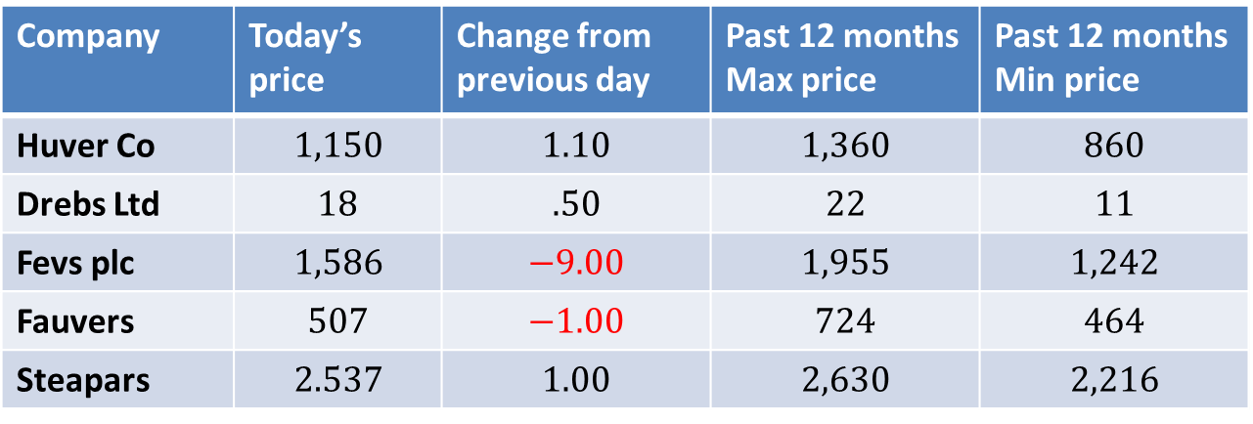
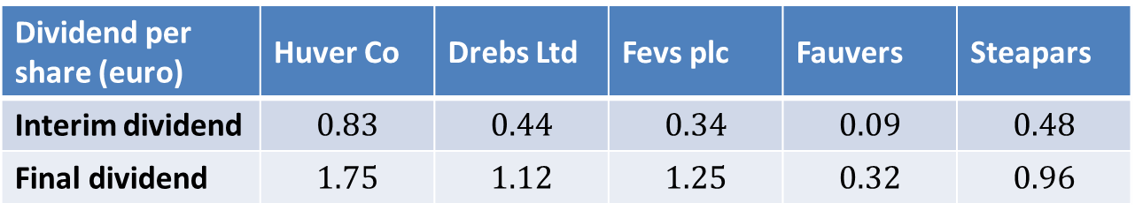
Which share had the largest difference between highest and lowest price over the last 12 months?
Share Prices
Company | Today’s price | Change from previous day | Past 12 months Max price | Past 12 months Min price
Huver Co | $$1,150$$ | $$1.10$$ | $$1,360$$ | $$860$$
Drebs Ltd | $$18$$ | $$.50$$ | $$22$$ | $$11$$
Fevs plc | $$1,586$$ | $$−9.00$$ | $$1,955$$ | $$1,242$$
Fauvers | $$507$$ | $$−1.00$$ | $$724$$ | $$464$$
Steapars | $$2.537$$ | $$1.00$$ | $$2,630$$ | $$2,216$$
Dividend per share (euro) | Huver Co | Drebs Ltd | Fevs plc | Fauvers | Steapars
Interim dividend | $$0.83$$ | $$0.44$$ | $$0.34$$ | $$0.09$$ | $$0.48$$
Final dividend | $$1.75$$ | $$1.12$$ | $$1.25$$ | $$0.32$$ | $$0.96$$
Note: the total annual dividend paid per share is the sum of the interim dividend and the final dividend
a) Huver Co b) Drebs Ltd c) Fevs plc d) Fauvers e)Steapars
Source: www.assessmentday.co.uk

Slide 9
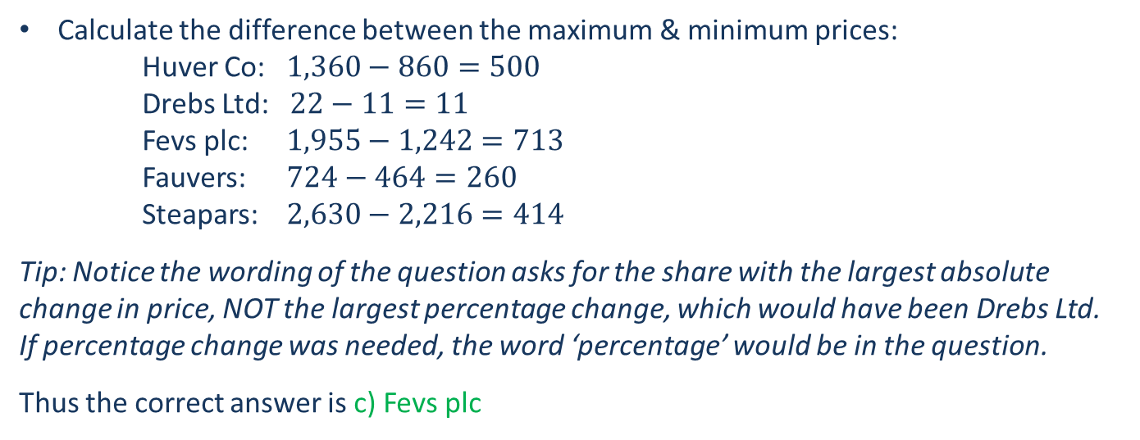
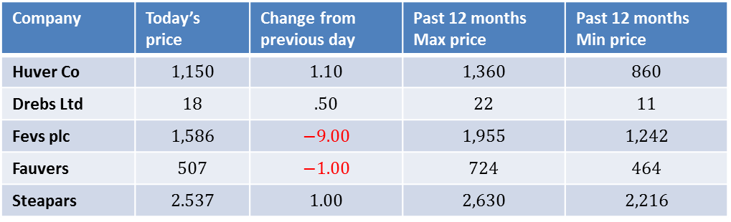
Which share had the largest difference between highest and lowest price over the last 12 months? - ANSWER
The information needed is in this table:
Company | Today’s price | Change from previous day | Past 12 months Max price | Past 12 months Min price
Huver Co | $$1,150$$ | $$1.10$$ | $$1,360$$ | $$860$$
Drebs Ltd | $$18$$ | $$.50$$ | $$22$$ | $$11$$
Fevs plc | $$1,586$$ | $$−9.00$$ | $$1,955$$ | $$1,242$$
Fauvers | $$507$$ | $$−1.00$$ | $$724$$ | $$464$$
Steapars | $$2.537$$ | $$1.00$$ | $$2,630$$ | $$2,216$$
Calculate the difference between the maximum & minimum prices:
Huver Co: $1,360−860=500$
Drebs Ltd: $22−11=11$
Fevs plc: $1,955−1,242=713$
Fauvers: $724−464=260$
Steapars: $2,630−2,216=414$
Tip: Notice the wording of the question asks for the share with the largest absolute change in price, NOT the largest percentage change, which would have been Drebs Ltd. If percentage change was needed, the word ‘percentage’ would be in the question.
Thus the correct answer is c) Fevs plc
Source: www.assessmentday.co.uk

Slide 10
In 1996, total output from all fuels was 200TWh. If output for Nuclear in 2006 was twice that for Coal in 1996, what was the output for Nuclear in 2006?
a) 140TWh b) 400TWh c) 64TWh d) 96TWh
Source: www.assessmentday.co.uk

Slide 11
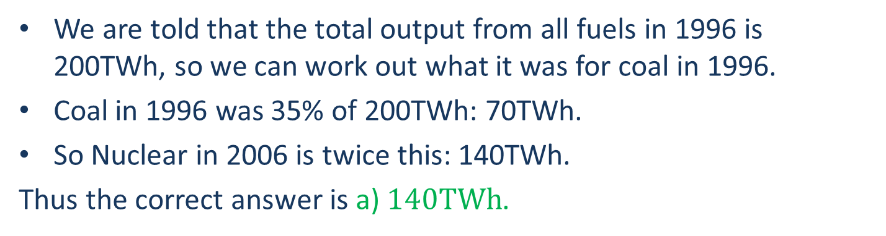
In 1996, total output from all fuels was 200TWh. If output for Nuclear in 2006 was twice that for Coal in 1996, what was the output for Nuclear in 2006? - ANSWER
We are told that the total output from all fuels in 1996 is 200TWh, so we can work out what it was for coal in 1996.
Coal in 1996 was 35% of 200TWh: 70TWh.
So Nuclear in 2006 is twice this: 140TWh.
Thus the correct answer is a) $140TWh$.
Source: www.assessmentday.co.uk

Slide 12
What was the average accident cost per vehicle on the road in Ribley in November?
Town |  | Aug | Sep | Oct | Nov | Average Cost per Accident (£)
Ribley | Number of Accidents | 8 | 6 | 12 | 10 | 1,900
 | Vehicles on Road | 85,000 | 76,000 | 79,000 | 81,000
Wartop | Number of Accidents | 14 | 18 | 4 | 20 | 3,200
 | Vehicles on Road | 112,000 | 101,000 | 89,000 | 117,000
Surren | Number of Accidents | 6 | 20 | 9 | 21 | 1,050
 | Vehicles on Road | 96,000 | 104,000 | 119,000 | 125,000
a) £0.23 b) £0.47 c) £15.40 d) £2.30
Source: www.assessmentday.co.uk

Slide 13
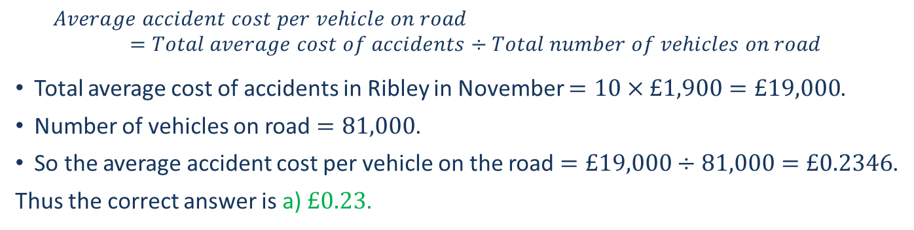
What was the average accident cost per vehicle on the road in Ribley in November? - ANSWER
Town |  | Aug | Sep | Oct | Nov | Average Cost per Accident (£)
Ribley | Number of Accidents | 8 | 6 | 12 | 10 | 1,900
 | Vehicles on Road | 85,000 | 76,000 | 79,000 | 81,000
Wartop | Number of Accidents | 14 | 18 | 4 | 20 | 3,200
 | Vehicles on Road | 112,000 | 101,000 | 89,000 | 117,000
Surren | Number of Accidents | 6 | 20 | 9 | 21 | 1,050
 | Vehicles on Road | 96,000 | 104,000 | 119,000 | 125,000
$$Average accident cost per vehicle on road$$
$$=Total average cost of accidents÷Total number of vehicles on road$$
Total average cost of accidents in Ribley in November $=10×£1,900=£19,000$.
Number of vehicles on road $=81,000$.
So the average accident cost per vehicle on the road $=£19,000÷81,000=£0.2346$.
Thus the correct answer is a) $£0.23$.
Source: www.assessmentday.co.uk

Slide 14
If the Building Energy Use today is 6% less than it was in 2000, by what percentage is today’s Building Energy Use lower than that of 1990?
a) 82.9% b) 17.1% c) 17.8% d) Cannot say
Source: www.assessmentday.co.uk

Slide 15
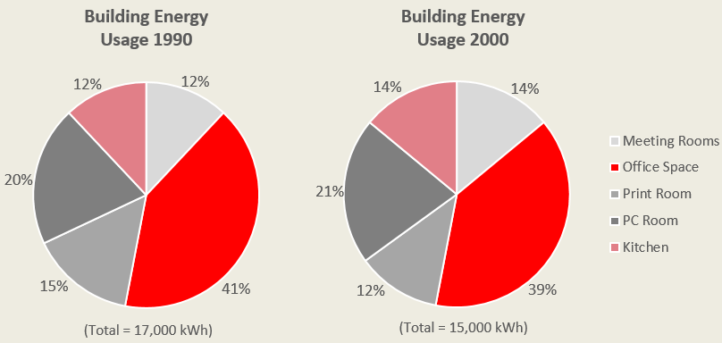
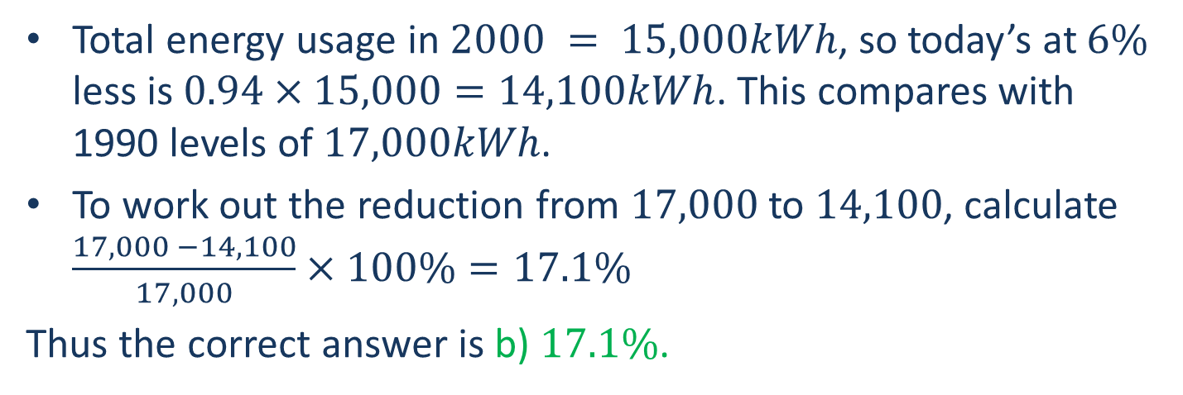
If the Building Energy Use today is 6% less than it was in 2000, by what percentage is today’s Building Energy Use lower than that of 1990? - ANSWER
Total energy usage in $2000 = 15,000kWh$, so today’s at $6\%$ less is $0.94×15,000=14,100kWh$. This compares with 1990 levels of $17,000kWh$.
To work out the reduction from $17,000$ to $14,100$, calculate $\frac{17,000 −14,100}{17,000}×100\%=17.1\%$
Thus the correct answer is b) $17.1\%$.
Source: www.assessmentday.co.uk

Slide 16
Preparing for tests
Research the type of test you may have to take
  Try an appropriate practice test
    Identify any weaknesses & address them
      Take a practice test again
        Have you improved?
Notes:
If you are likely to apply to companies using tests to assess numerical reasoning,
1. Find out:
What skill or skills they test for
Which tests they use
Whether they have example questions on their website
2. Try out an appropriate test e.g. numerical reasoning. Ideally one that provides the answers when you have finished to help you identify where you went wrong e.g. the tests on the Assessmentday website or Graduates First (links to these sites follow).
3. Look at your result and any tips or comment that might be provided with it:
Is the result high enough?
Are there gaps in your knowledge that you need to address e.g. some questions that you find more difficult? If so, refresh or improve your knowledge of the specific topic. Seek help if you need to e.g. Maths support or English language support within your university.
Take another practice test when you have addressed any weaknesses
5. If you have not improved, seek advice e.g. from your university careers service.

Slide 17
Preparing for tests – Research
Look at employers’ websites to see the type of tests they use, e.g. numerical reasoning.
The website may also have example questions and tell you whose tests they use.
Look at websites like Glassdoor or Wikijobs for feedback from others who have already applied to the same employer.

Slide 18
Preparing for tests – Practise
When you know the type of test you may face, get some practice first, e.g. the tests on the Assessment Day or Graduates First websites.
If you know which test producer the employer uses, see if there are example questions on the producer’s website. Many of these are listed later in this presentation.

Slide 19
Preparing for tests – Identify weaknesses
Trying one or more practice tests should help you to identify areas that you may need to refresh or develop, e.g. ratios, fractions, percentages.
You should also be able to identify if you work quickly enough or if you have problems with accuracy, e.g. working quickly but not checking your answers.

Slide 20
Preparing for tests – Address weaknesses
Revise any weak areas in your maths skills. Useful resources are listed later in this presentation.
Take more tests to practise improving your speed or to practise taking more care with your answers.
With some tests, it is not always necessary to answer all of the questions to do well. You just need to get enough answers correct.

Slide 21
Preparing for tests – Review
When you have worked on your weaknesses, try a practice test again, e.g. Assessment Day, Graduates First or examples on test producers’ websites.
If you have not improved, try the previous steps again and contact your university careers service for help and advice.

Slide 22
Numerical Reasoning Practice Test
https://www.assessmentday.co.uk/aptitudetests_numerical.htm
Notes:
Tutors: this would be a good point for students to try one of the 2 free practice tests on the Assessmentday website, under test conditions. Decide if you want them to do a paper test. If so, print off copies of one of the free tests (and copies of the solutions). Alternatively, if you are able to use a computer lab or instruct students to bring their own laptop or tablet/ipad they can take the test online.
You can follow these steps:
Stop the presentation at this point. Before moving on to the test, ask if students need a quick break (once the test has started they should not leave the room, except in emergencies).
When everyone is ready, distribute the printed test or instruct students to log in using one of the links above
Instruct students not to turn over the front page or to start the test yet
Ask them to read the instructions as you read them out loud. Display them on screen if students are completing the test online
Ask if they have any questions before you start
Instruct them to start the test
Set a stop watch when the test starts (also note the time in case the stopwatch fails)
At the end of the paper test, instruct them to stop. The online test stops automatically
Give out the solutions paper and students can mark their own test. Students completing the test online receive their result immediately but can then look at the answers to see where they have gone wrong.
Return to the remaining slides when you and the students are ready.

Slide 23
Practice Tests Offered by Test Producers
CEB Gartner (SHL)
https://www.cebglobal.com/shldirect/en/practice-tests
Cubiks
https://practicetests.cubiks.com/
Talentlens (Pearson)
https://www.talentlens.co.uk/practice-aptitude
Saville Assessment
https://www.savilleassessment.com/PracticeTests
TalentQ
https://www.trytalentq.com/
Capp
http://practice.cappassessments.com/
You may have to register & create a password before taking a practice test
Notes:
These well known companies produce tests to be used in recruitment. They publish example questions and in some cases, practice tests too. Many of these sites will require you to register, with basic personal details, and create a password in order to take their practice test. Some may offer the opportunity to take a new test as part of a trial.

Slide 24
Help with improving your maths skills
Find out if your university has a maths support service
Online courses and resources, e.g.
https://www.futurelearn.com/courses/numeracy-skills

Slide 25
Online help with improving your Maths skills
http://www.mathcentre.ac.uk/
http://www.statstutor.ac.uk/
https://www.khanacademy.org/
http://www.mathcentre.ac.uk:8081/mathseg/
http://www.wolframalpha.com/
https://www.intmath.com/
http://www.cse.salford.ac.uk/physics/gsmcdonald/hFLAPM.php

Slide 26
Help with understanding tests
Ask your university careers service what help and support you can get. They may offer some or all of the following:
Information about taking tests on their websites
Opportunities to practise tests and receive feedback
Discussion with an adviser to address your concerns
Links to websites with practice tests

Slide 27
Thank you
Any questions ???

